Slide 1




Introduction to Life Insurance
Notes:
Audio: This is a small sample of one of our courses. The left mouse click will advance you to the next screen.

Slide 2

Course Description and Objectives
Course Descriptions
Course Objectives
Introduction to life insurance is developed for new agents and explains how to sell life insurance. Topics includes understanding life insurance products, analyzing financial needs, making value-added recommendations to clients, and preparing for a successful career.
Upon completion of this course, you should be able to:
Analyze individual and family needs
Identify insurance products to meet the needs
Provide valuable services to clients
Develop effective work habits that enable success
Notes:
This course is for new agents and it explains how to sell life insurance. Read the objectives before continuing.

Slide 3

Table of Contents
Module 1:
Life Insurance and the Producer
Module 3:
Conducting a Needs Analysis
Module 2:
Client Presentations
Module 4:
Success Preparations
Notes:
There are 4 modules: life insurance and the producer, how to make client presentations, conduct a needs analysis and prepare you for success.

Slide 4
Life Insurance and the Producer
Module 1
Notes:
Let’s start with the first module.

Slide 5

The Insurance Producer
Your life is not secure
Life Insurance provides security
Notes:
Audio:
As an insurance producer, you will often carry a dual message to your clients. By conducting a thorough needs analysis, you will be able to identify the life insurance products that can make your clients lives more secure. However, you might also call attention to those areas where they are not secure.
Ultimately, the better your product knowledge and sales presentation skills, the more value you will add to your clients, and this course prepares you for both.

Slide 6
Who Needs Life Insurance?
Family
Mortgage
Business
College
Notes:
Video:: While your client's needs will differ, everyone is expected to have either a family, home, business or someone desiring to go to college. Life insurance can be used to meet all of these needs.

Slide 7
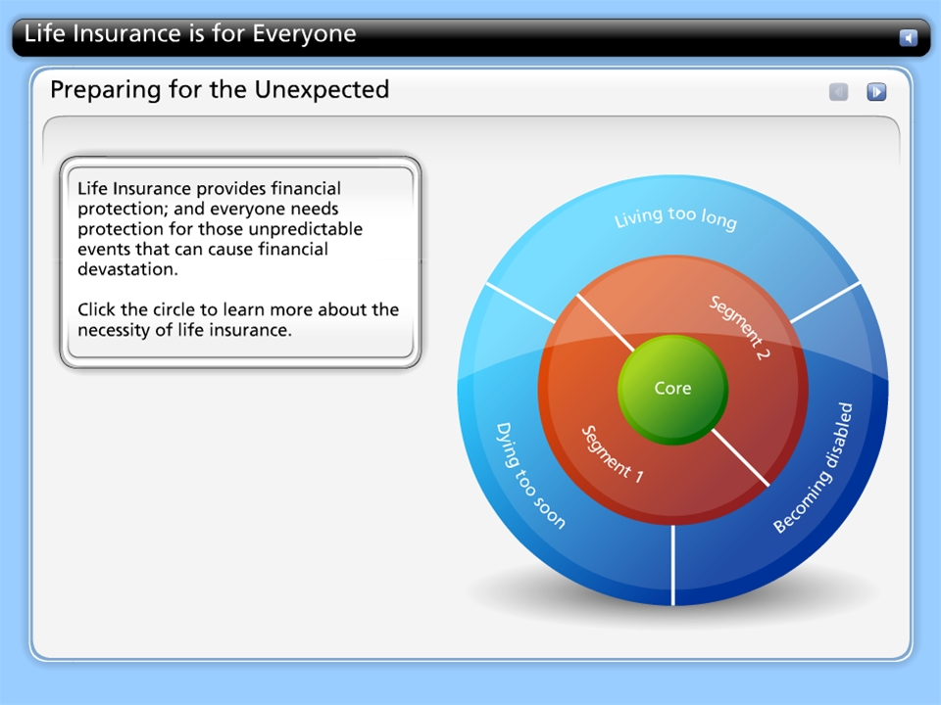



Life Insurance is for Everyone
Notes:
This is an example of one of the interactive tools we utilize. In the full-version of the course, learners will learn more by exploring the different segments of the diagram.

Slide 8



Life Insurance as a Solution
Notes:
Audio: (edited/ready)
Synch pics with audio
‘Whether your loved one died too soon, was blessed with a longer life than expected, or become disabled, life insurance can guarantee the financial security a family needs if something happened to the primary income earner.

Slide 9

Challenges met by Life Insurance: Living Longer


Notes:
As we live longer, often our earnings do not and, in retirement, they are much less and do not allow us to maintain the same lifestyle. Ultimately, while it is a blessing to have longer life, the downside is that most of us are not adequately prepared for retirement.
------’
Do not record
….” according to the USC Leonard Davis, School of Gerontology (accessed March 24, 2018). Americans are today enjoying higher life expectancy

Slide 10
Rule of 72
You can calculate the rate of inflation for your prospects by using the Rule of 72, which allows you to divide 72 by the assumed rate of inflation and return an approximate number of years in which a given amount of money will double.
72
Assumed Rate of Inflation
Years for $ to double
Click here for calculated example:
Notes:
When preparing for retirement, it is important to consider inflation, which diminishes the dollar’s purchasing power over long periods of time. The rate of inflation can be calculated using the Rule of 72.
Calculated example: Let’s say we have an insured, age 25 with $50,000 of life insurance coverage. Using the Rule of 72 and a conservative 3% inflation, the coverage would have to double by age 49 (i.e., 24 years). And double again by age 73 to maintain its original purchasing power—not to mention the standard of living.

Slide 11

Solution 1: Life Insurance and Annuities
Client goal: Be comfortable as they age.
Notes:
Life insurance and annuities are practical solutions to meet the needs of dying too soon or, being blessed with, living too long. They can provide cash in the event of an unexpected death or lifetime incomes so that your clients can be comfortable as they age.

Slide 12

Solution 2: Disability Income Insurance
Disability Income Insurance can breach the financial gap and replace a major part of lost income to ease the family’s financial problems during the disability.
Notes:
Audio: Disability Income Insurance can enable a family to maintain a similar lifestyle that they had prior to the disability.
For example, If your customer was to become disabled and was unable to work for an extended period of time, how would the family manage the loss of income and, potentially, additional medical expenses? These are the challenges a family faces when an income earner becomes disabled.

Slide 13
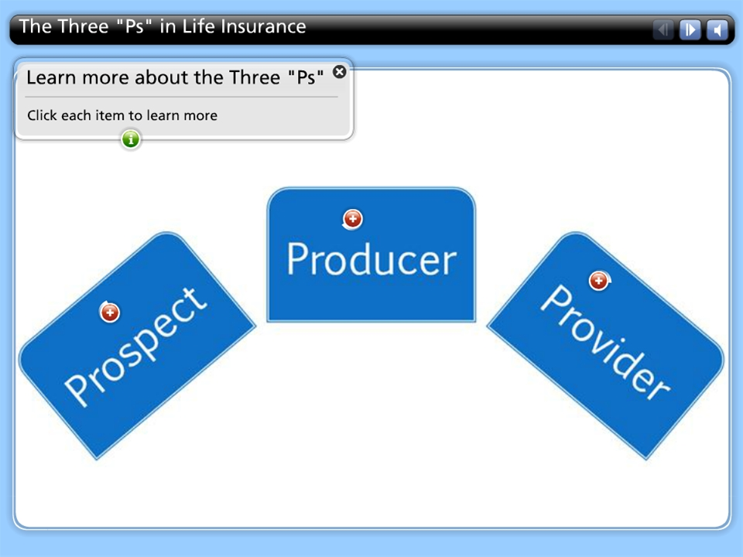
The Three "Ps" in Life Insurance
Notes:
Audio: Unlike, property and casualty insurance that protects tangible properties; life insurance, annuities and disability income products are intangible policies that will provide future benefits; therefore, they are rarely purchased without YOU, the producer, assessing the prospect’s need and demonstrating how provider’s policy can meet the need.
Here is another interactive activity that is not active in this sample, but the learner would select the 3 Ps to learn more about each of them.

Slide 14
Module Summary
You have completed Life Insurance and the Producer.
Describe the challenges that can be met by life insurance
Explain who needs life insurance
You should now be able to:
Discuss your role as a producer
Calculate assumed inflation rates
Notes:
You have completed the sample module. Next, I’ll explain additional featues that could be added to your course.

Slide 15
Quiz/testing/compliance
Need CPE credit?
NASBA compliance?
Notes:
We can integrate testing to meet the requirements of your organization or (NASBA) if your course requires CPE credits.

Slide 16
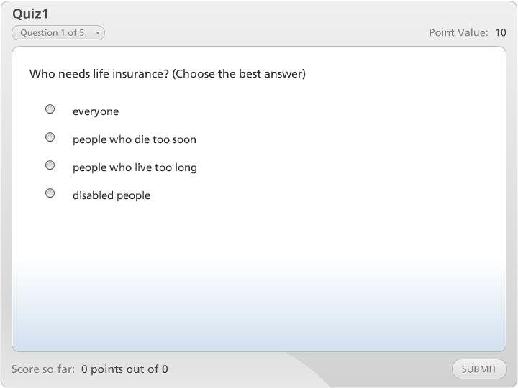

Quiz1
Need an LMS?
We customize the learning management system to meet your needs.
Notes:
Here is a sample question. If required, we are also able to provide an LMS to keep track of your learners scores and progress.
This concludes the sample course. Please connect with your consultant if you would like to see additional samples.
Thank you!

Slide 17
Conducting the needs analysis
Module 2
Notes:
Use Fact-Finding content from Opus course

Slide 19
Module one quiz

Slide 20
Client presentations
Module 2

Slide 21
Module two quiz

Slide 22
Module 3

Slide 23
Module three quiz

Slide 24
Module 4

Slide 25
Module four quiz

Slide 26
Title and Content Layout with List
Add your first bullet point here
Add your second bullet point here
Add your third bullet point here

Slide 27
Title and Content Layout with Chart

Slide 28
Two Content Layout with Table
First bullet point here
Second bullet point here
Third bullet point here
Class | Group 1 | Group 2
Class 1 | 82 | 95
Class 2 | 76 | 88
Class 3 | 84 | 90

Slide 29
Title and Content Layout with SmartArt
Step 1 Title
Task description
Task description
Task description
Task description
Step 2 Title
Task description
Task description
Task description
Step 3 Title
Task description
Task description
Step 4 Title
Task description
Task description

Slide 30

Picture with Caption Layout
Caption

Slide 31
Add a Slide Title - 1

Slide 32
Add a Slide Title - 2

Slide 33
Add a Slide Title - 3

Slide 34
Add a Slide Title - 4

Slide 36
Add a Slide Title - 5

Slide 38
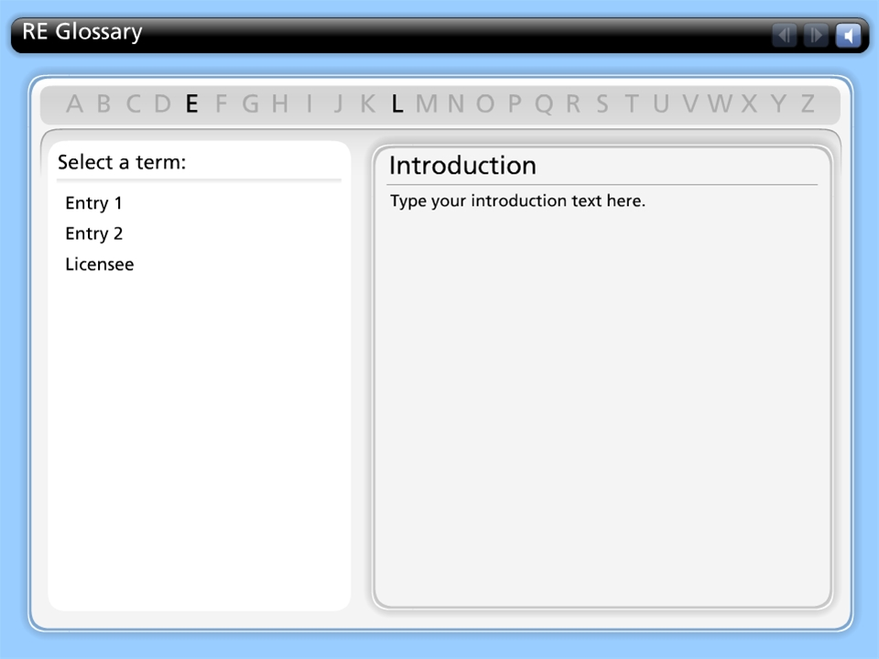
RE Glossary
Notes:
Licensee

